Slide 1
Employee management database
Made by Reena tamang

Slide 2
EASY LEVEL QUESTIONS

Slide 3

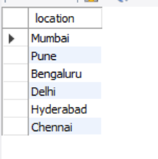
1. List all distinct locations where departments are based.

Slide 4
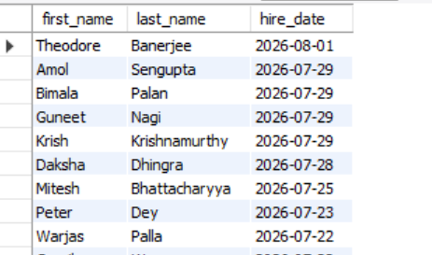
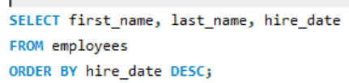
2. Display employee first name, last name, and hire date, sorted by the most recently hired first.

Slide 5
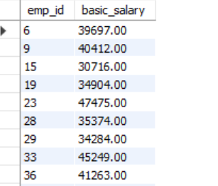
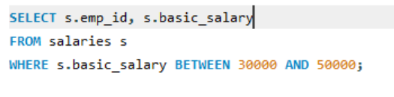
3. Find all employees whose basic_salary is between 30000 and 50000.

Slide 6
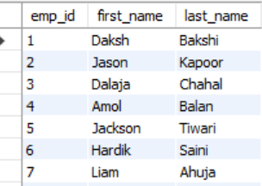
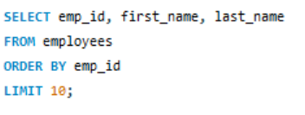
4. Show the top 10 employees in the employees table (by emp_id).

Slide 7
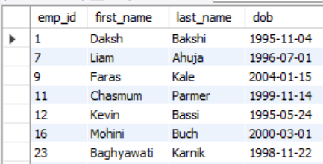
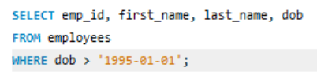
5. Find all employees who were born after 1995-01-01.

Slide 8
INTERMEDIATE LEVEL QUESTIONS

Slide 9
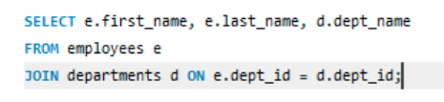
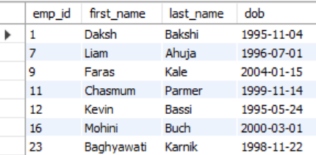
1. List each employee's full name along with their department name.

Slide 10
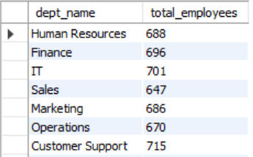
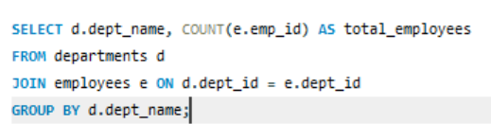
2. Find the total number of employees in each department.

Slide 11
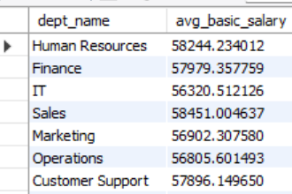
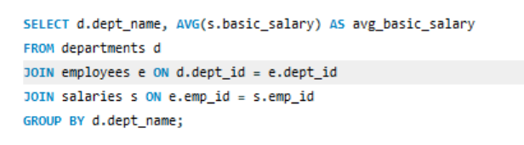
3. Display the average basic salary for each department.

Slide 12
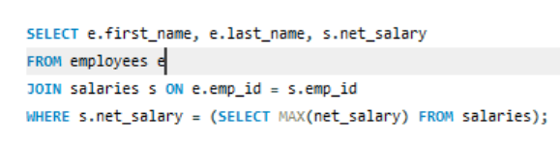

4. Find the employee(s) with the highest net salary.

Slide 13
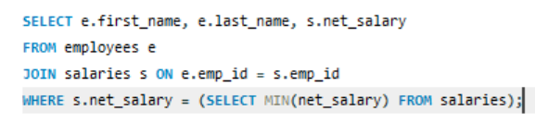

5. Find the employee(s) with the lowest net salary.

Slide 14
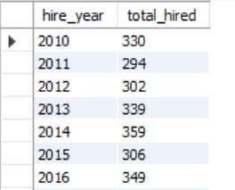
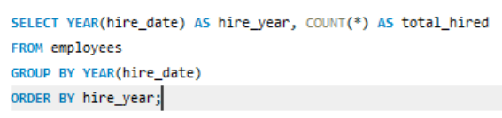
6. Find the number of employees hired in each year.

Slide 15
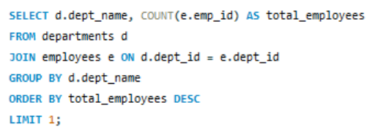

7. Show the department name with the maximum number of employees.

Slide 16
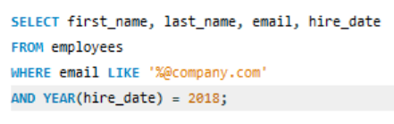
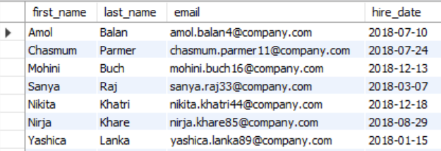
8. List employees whose email domain is @company.com and hired in the year 2018.

Slide 17
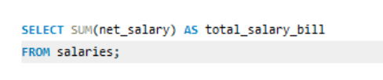

9. Find the total salary bill (sum of net_salary) paid company-wide.

Slide 18
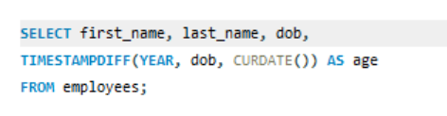
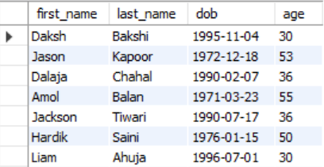
10. Display employees along with their age (calculated from dob).

Slide 19
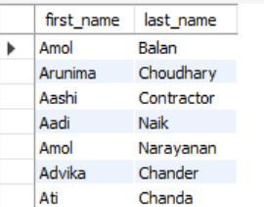
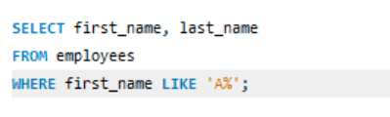
11. Find employees whose first name starts with "A".

Slide 20
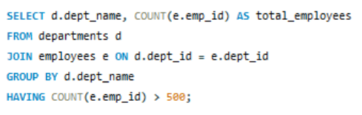
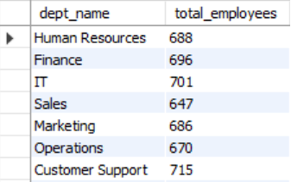
12. List departments that have more than 500 employees.

Slide 21
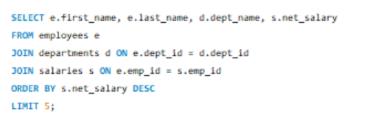
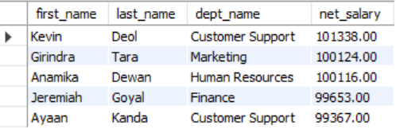
13. Show the top 5 highest-paid employees along with their department name.

Slide 22
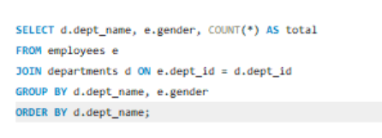
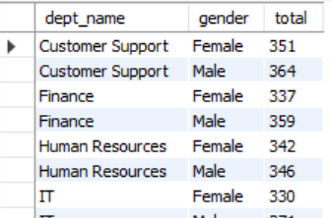
14. Find the number of male and female employees in each department.

Slide 23
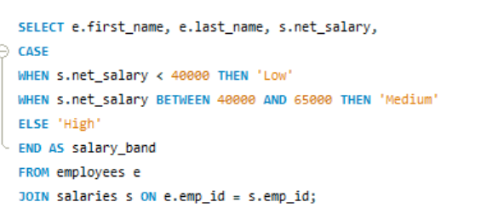
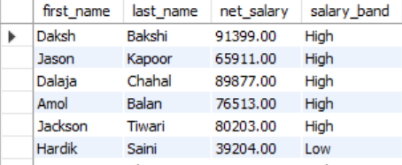
15. Categorize each employee into a salary band (Low / Medium / High) using CASE.

Slide 24
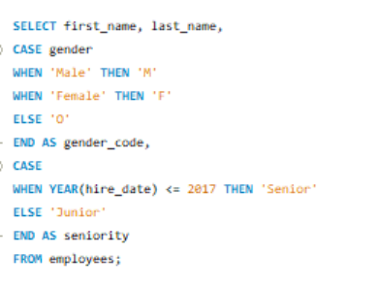
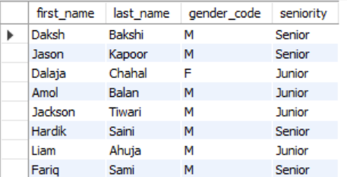
16. Display gender as short codes (M/F) and label employees as "Senior" or "Junior" based on hire year, using CASE.

Slide 25
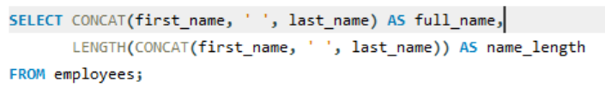
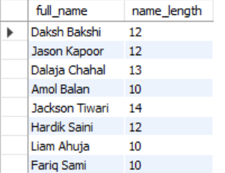
17. Display each employee's full name (concatenated) along with the number of characters in it.

Slide 26
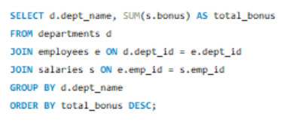
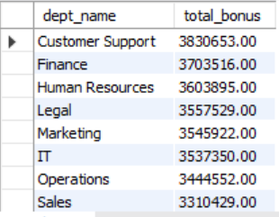
18. List each department along with the total bonus paid, ordered from highest to lowest.

Slide 27
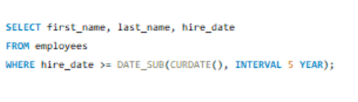
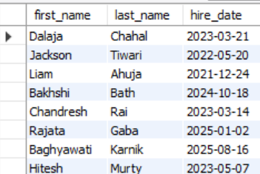
19. Find employees who joined in the last 5 years (relative to today's date).

Slide 28


20. Find the total number of distinct departments that actually have at least one employee.

Slide 29
HARD LEVEL QUESTIONS

Slide 30
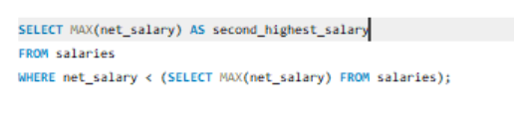

1. Find the second highest net salary in the company.

Slide 31
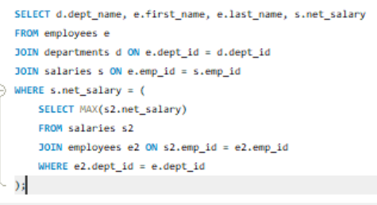
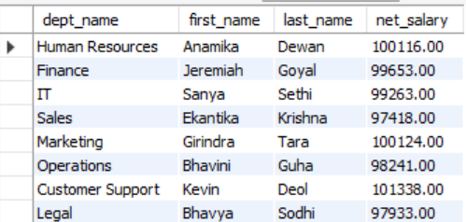
2. For each department, find the employee with the highest net salary.

Slide 32
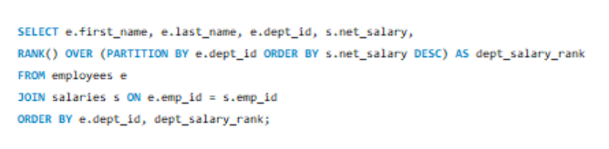
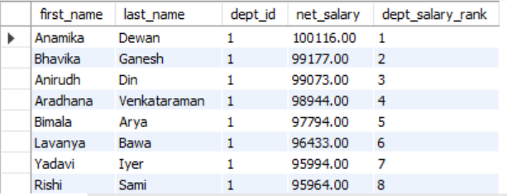
3. Rank employees within each department by net_salary using RANK() OVER (PARTITION BY ...).

Slide 33
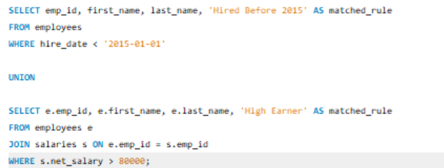
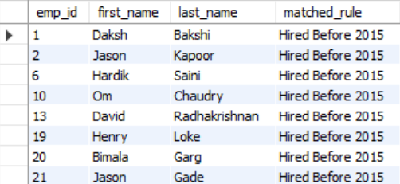
4. Combine two employee groups — those hired before 2015 and those earning above 80000 — into one result using UNION.

Slide 34


5. Create a VIEW that shows each employee's full salary details with department name, then query it.

Slide 35
THANK YOU!

